Slide 1



Power Pi Engineer Track
Final Graduation Project

Slide 2

Team Members
Team Members
Alaa Mohammed
Asmaa Bedawi
Zainab Usamh
Ghada Ibrahim
Noha Sayed

Slide 3

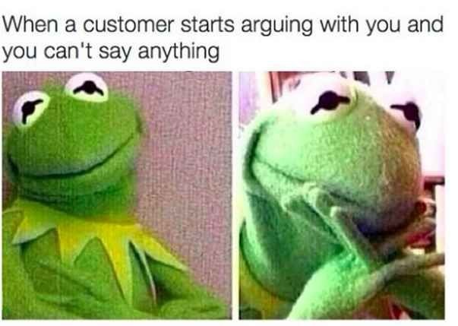
Could you guess our problem!!

Slide 4

Agenda
Introduction
Data Cleaning and Preprocessing
Analysis Questions Phase
Dashboard
Conclusion
Q&A

Slide 5

Project Overview
Project Title
Power BI Call Center Performance Dashboard
Objective
Create a comprehensive Power BI dashboard to analyze and visualize key performance indicators (KPIs) for call center.
Target Audience
Call Center Managers, Data Analysts, Operations Team

Slide 6

Business Problem
Call Duration
The call duration is tracking within the target range, allowing ample time to address the customer's concerns.
Hold Time
The customer has been on hold for only a brief period, minimizing frustration and maintaining engagement.
First Call Resolution
The representative is working to resolve the issue on the first call, avoiding the need for repeat contacts.

Slide 7


Slide 8

Business Questions
Overall Call Center Performance:
How has the total volume of calls (answered and missed) changed compared to the same period last year?
What is the trend in customer satisfaction (CSAT), and how does it compare to last year?
What is the first call resolution (FCR) rate this year versus last year?
Has the average handle time (AHT) improved or worsened compared to last year?
Department-Level Performance:
Which departments are handling the most calls, and how does their performance compare (AHT, CSAT, FCR)?
Are any departments experiencing more missed calls, and why?
Hourly Performance:
What are the busiest hours of the day, and how is performance (AHT, CSAT, FCR) during these times?
Are there specific hours with consistently lower customer satisfaction or resolution rates?
Performance Trends and Improvements:
How does overall performance this year compare to last year? What areas have improved or declined?

Slide 9


Data Acquisition and Preparation
The project draws data from various CSV files and an Excel workbook containing:
Call records
Abandoned calls
Agent details
Department information
Customer surveys
Data Sources

Slide 10

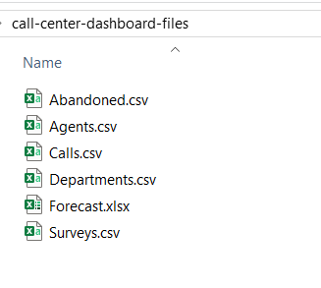
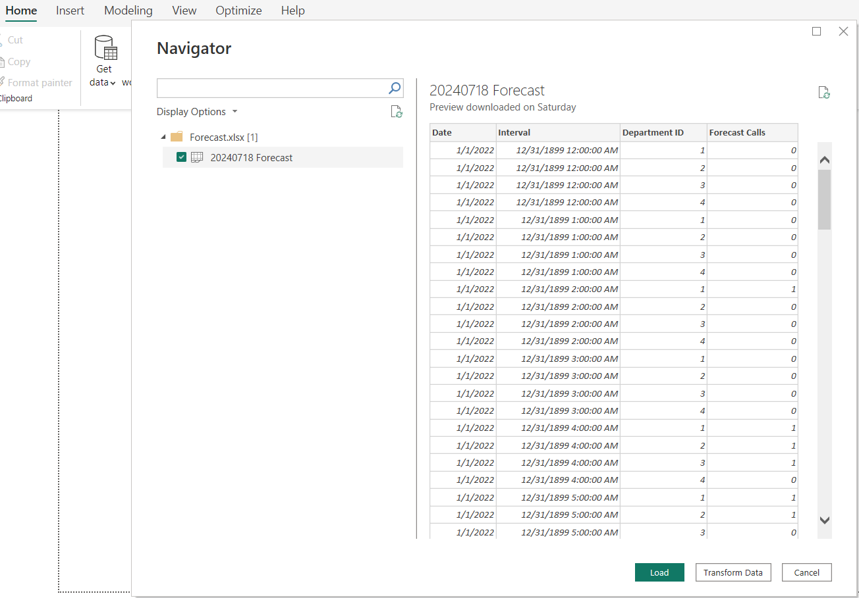

Data Cleaning and Preprocessing
1 - Import the call center data into Power BI from various CSV files and an Excel workbook containing: (Abandoned, Agents, Calls, Departments, Forecast,and Surveys) sheets.

Slide 11
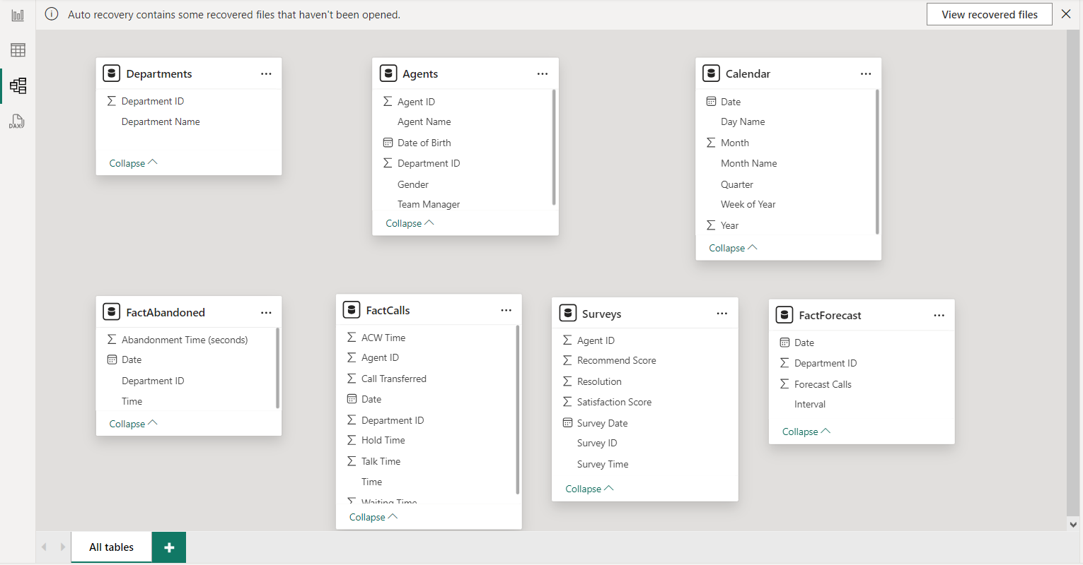
Data Model
Data Before Modelling :

Slide 12
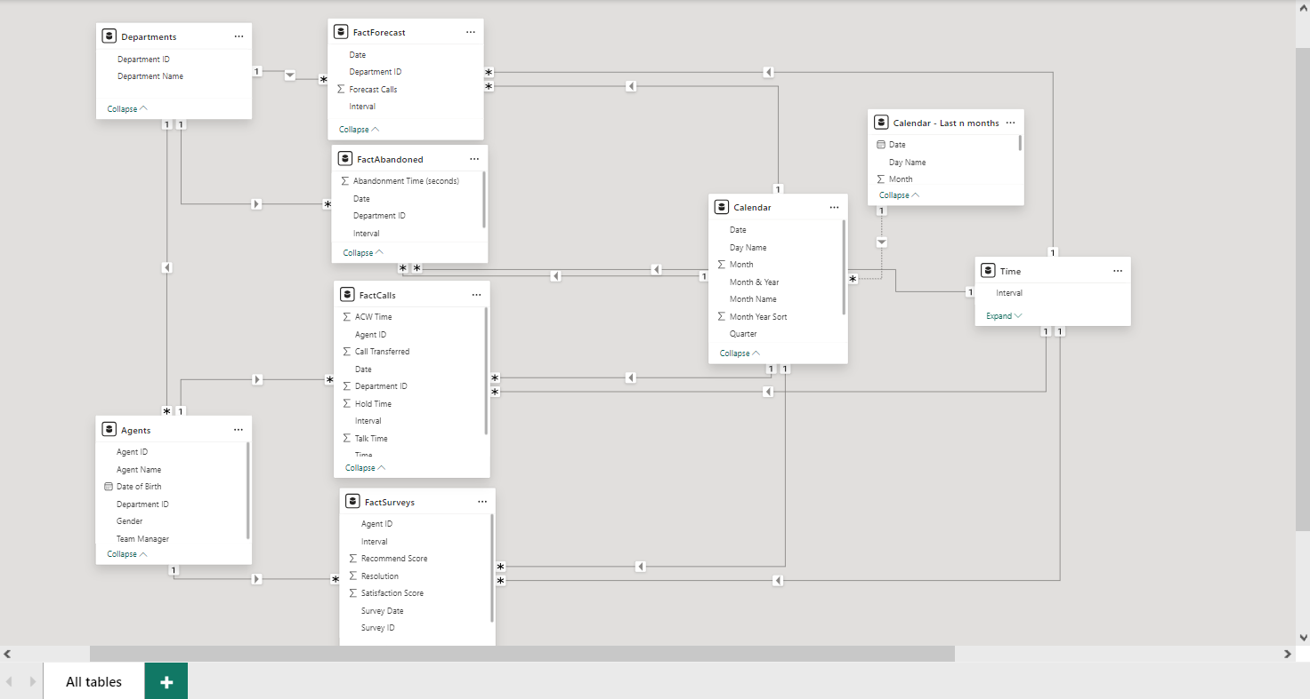
Data Model
Data After Modelling :

Slide 13
Analysis Questions Phase
Performance Metrics
How do actual call volumes compare to forecasted volumes by department?
What is the relationship between AHT and call abandonment rates?
Operational Efficiency
What percentage of calls are abandoned, and how does it vary by time of day?
Are there specific intervals with higher abandonment rates?
Trend Analysis
How do key KPIs trend over selected months or years?
How does current performance compare to the same period last year?
Agent Performance (Future)
What are the performance metrics for individual agents?
Are there agents who consistently underperform or excel?
Customer Experience
How do customer survey results correlate with AHT and abandonment rates?
What patterns in feedback suggest areas for improvement?
Resource Allocation
How can staffing be optimized based on forecasted call volumes?
What are the peak call times for resource allocation?

Slide 14
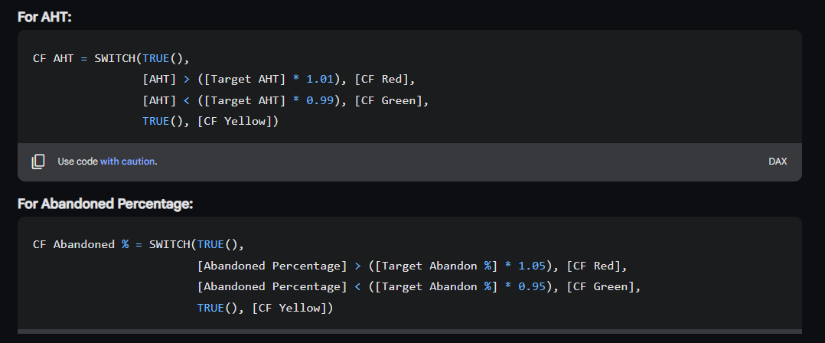
Measures

Slide 15
DAX Formulas:
1. Calls Answered: CALCULATE(COUNTROWS('Fact Calls’))
2. Forecast Calls: CALCULATE(SUM('Fact Forecast'\[Forecast Calls\]))
3. Abandoned Calls: CALCULATE(COUNTROWS('Fact Abandoned Calls’))
4. Abandoned Percentage: DIVIDE(\[Abandoned Calls\],\[Calls Answered\],0)
5. Total Talk Time: CALCULATE(SUM('Fact Calls'\[Talk Time\]))
6. Total Hold Time: CALCULATE(SUM('Fact Calls'\[Hold Time\]))
7. Total ACW Time: CALCULATE(SUM('Fact Calls'\[ACW Time\]))
8. AHT (Average Handling Time): DIVIDE(SUMX('Fact Calls', \[Total Talk Time\] + \[Total Hold Time\] + \[Total ACW Time\]),\[Calls Answered\],0)
9. Actual to Forecast Percentage: DIVIDE(\[Calls Answered\],\[Forecast Calls\],0)
10. Calls Answered Previous Year: CALCULATE(\[Calls Answered\], SAMEPERIODLASTYEAR('Calendar'\[Date\]))
11. Actual to Forecast Percentage Same Period Last Year: CALCULATE(\[Actual to Forecast %\], SAMEPERIODLASTYEAR('Calendar'\[Date\]))
12. Abandoned Percentage Same Period Last Year: CALCULATE(\[Abandoned Percentage\], SAMEPERIODLASTYEAR('Calendar'\[Date\]))
13. Selected Date: SELECTEDVALUE('Calendar'\[Date\])

Slide 16
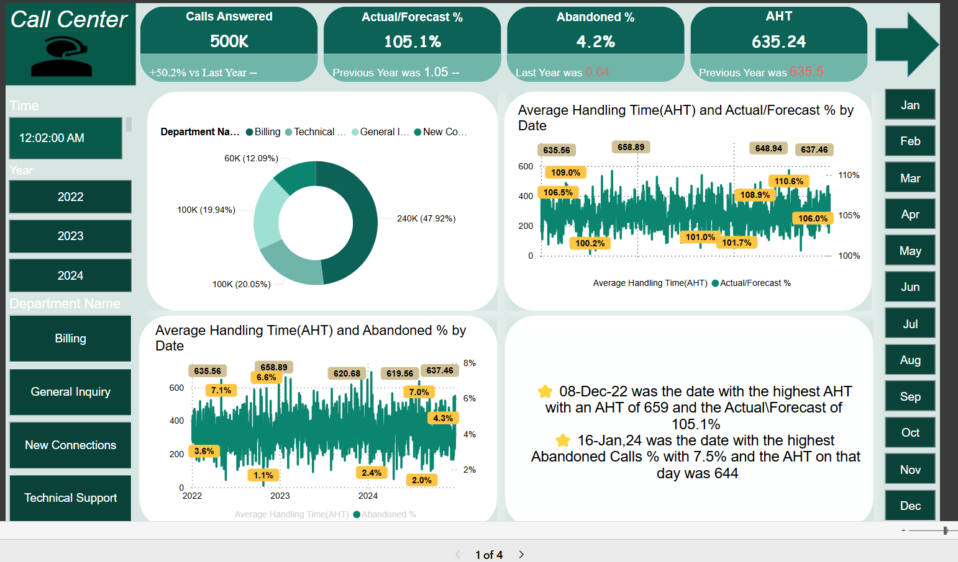
REPORT

Slide 17
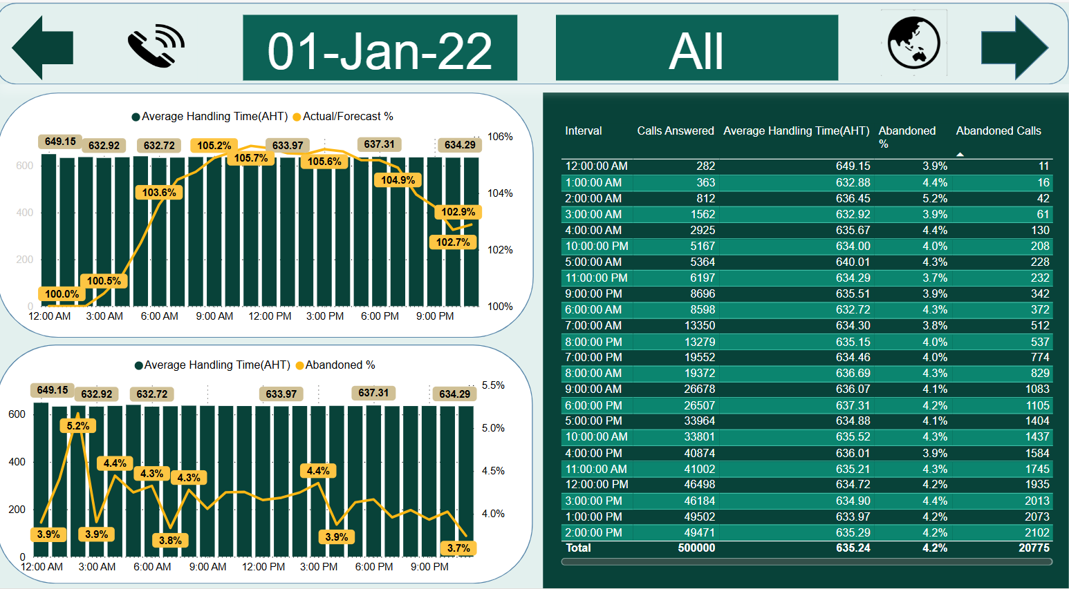
REPORT

Slide 18
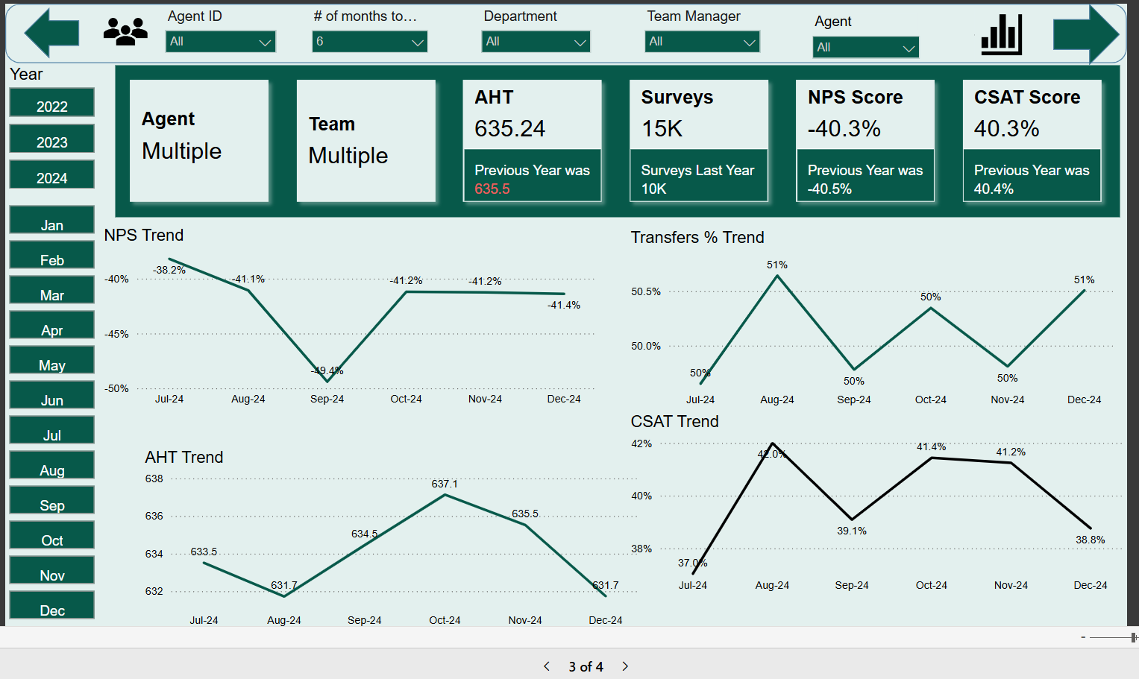
REPORT

Slide 19
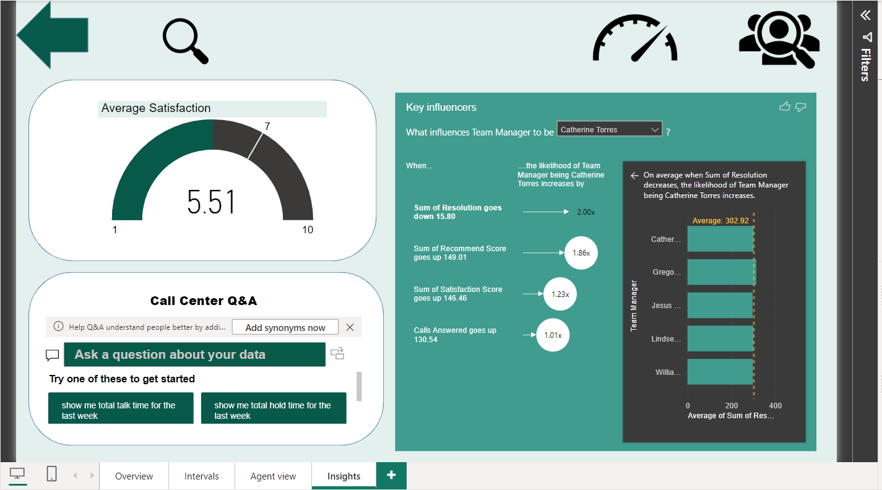
INSIGHTS

Slide 20
Recommendations
Interpreting results:
Recommendations:
1. Improve Call Handling Efficiency
Enhance Resolution Rates
Optimize Interaction Quality
Increase Answered call Rate
Efficient Call Handling
Personalized Service and Feedback

Slide 21
Conclusion
This dashboard delivers essential insights into call center performance, helping managers identify trends, track KPIs, and analyze efficiency across departments and time intervals. It enables proactive decision-making by clearly presenting the data.

Slide 22

References
ChatGPT
https://gamma.app/
https://excel-bonanza.ck.page/002d99cc48
https://harpa.ai/welcome
YrGz/?utm_source=share&utm_medium=member_desktophttps://github.com/piyush5ingh/PWC_task_Call_center_solution_Power_BI
https://medium.com/@rahmaarditap/analyzing-call-center-performance-a-comprehensive-dashboard-with-power-bi-0fb8aed889b2#:~:text=T%20he%20Call%20Center%20Performance%20Dashboard%20is%20designed%20to%20present
https://datatoinfolabs.com/call-center-data-analysis-in-power-bi-dashboard-project/#:~:text=Through%20this%20article%20you%20will%20get%20an%20understanding%20of%20how
https://github.com/rupsa723/call-center-dashboard

Slide 23


Slide 24
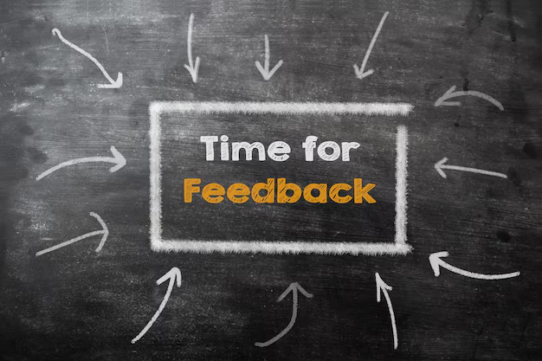

Slide 25


